Slide 1
Design Project: Knock Pattern Recognition
Ralph Quinto, Raphael Rezkalla, Bryan Jimenez

Slide 2
Overview
Using a Piezo sensor, we developed a circuit that detects a knock pattern and unlocks the electronic lock
This project was developed in the MBED compiler using C++
The STM32L476VG microcontroller was used for the development of this project

Slide 3
Challenges
The first challenge was determining the threshold required to detect an input
Another challenge was in resetting the lock once the pattern was entered

Slide 4
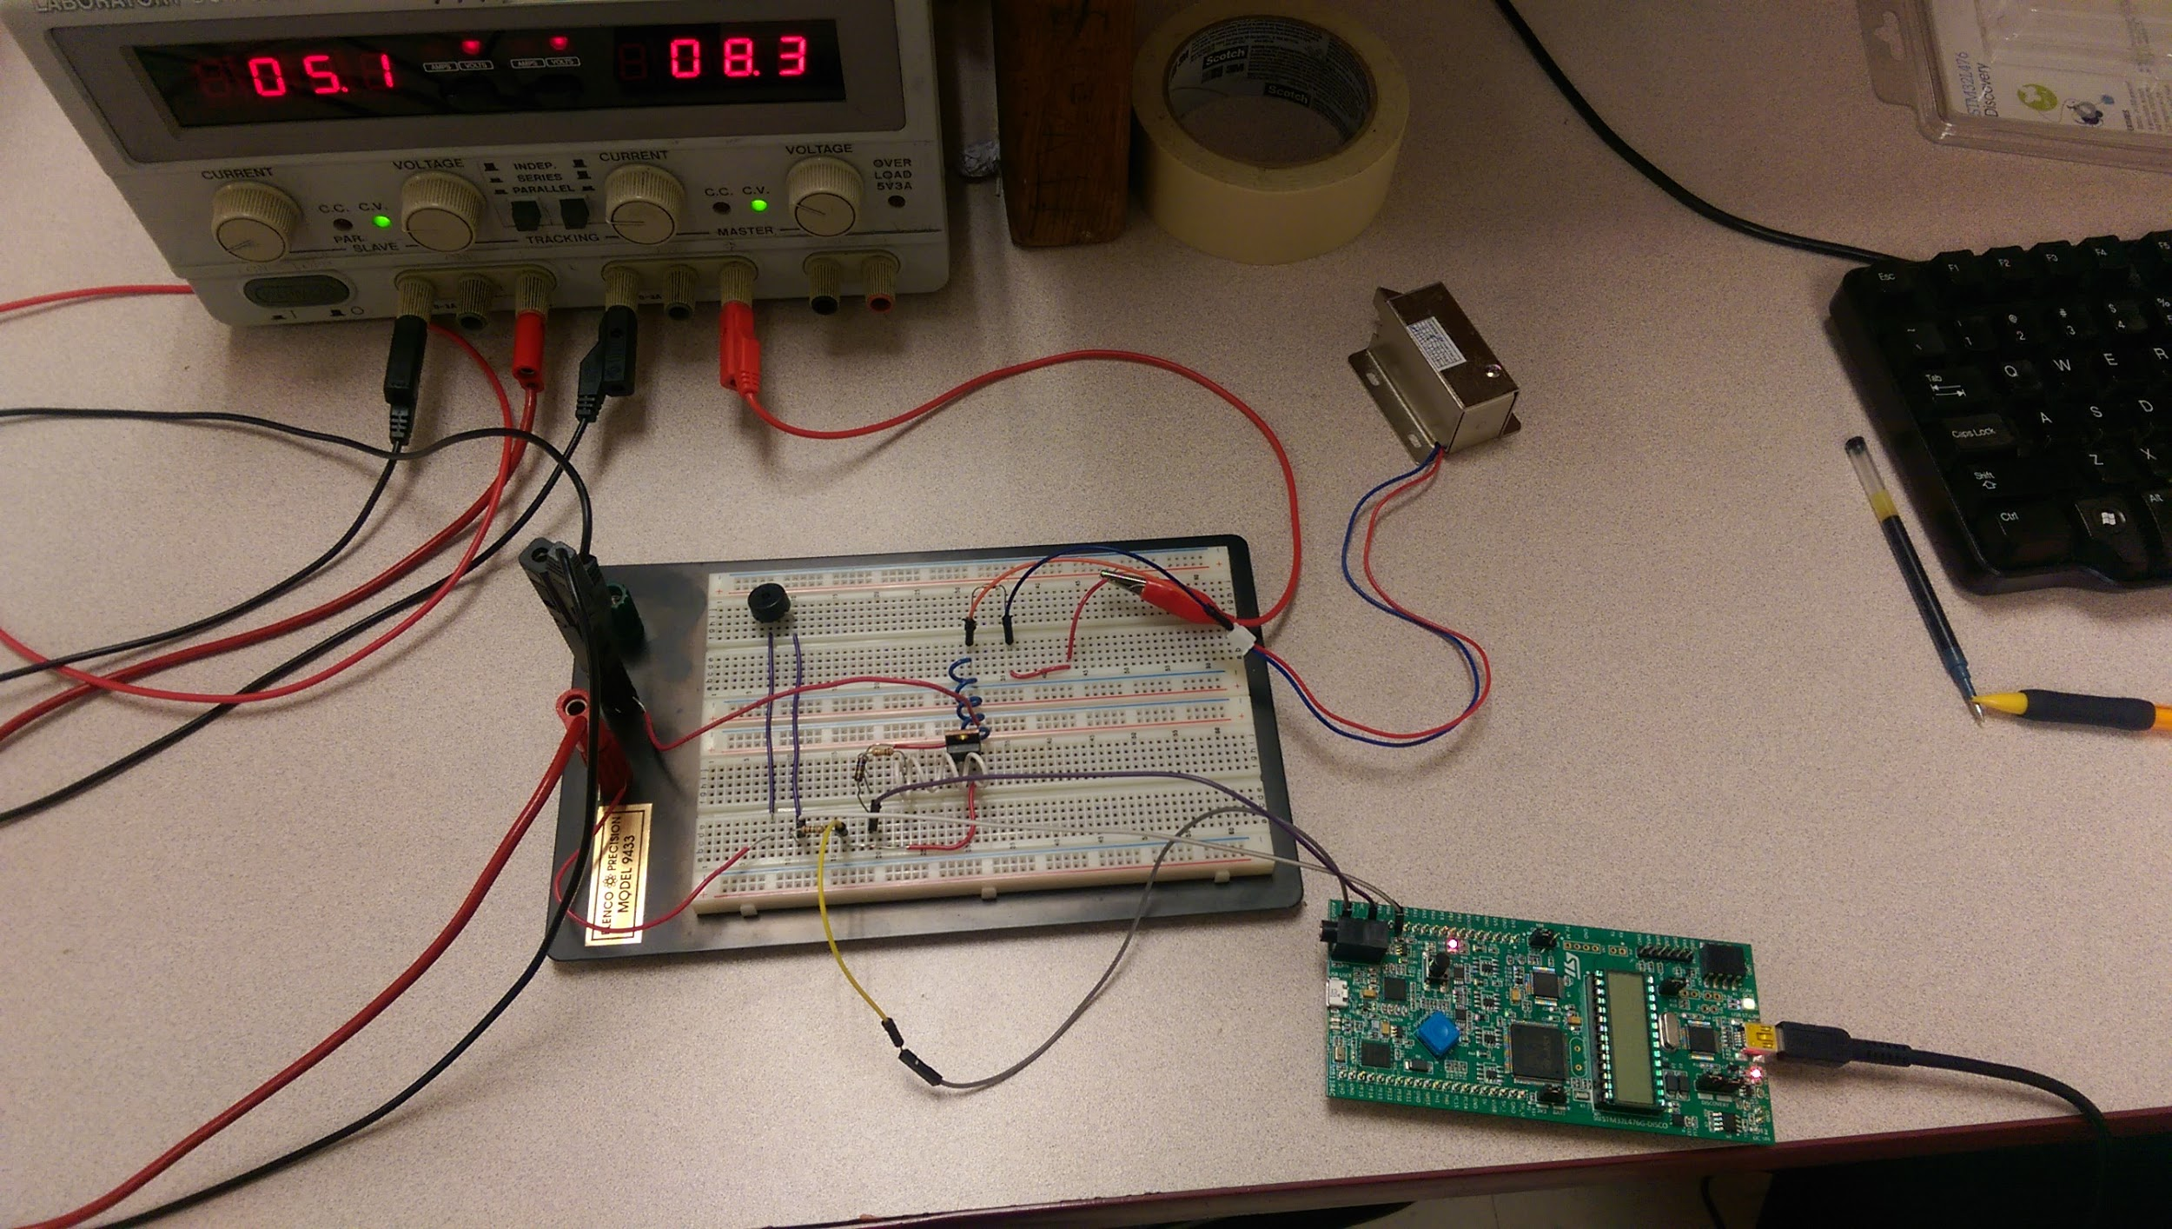
Circuit

Slide 5
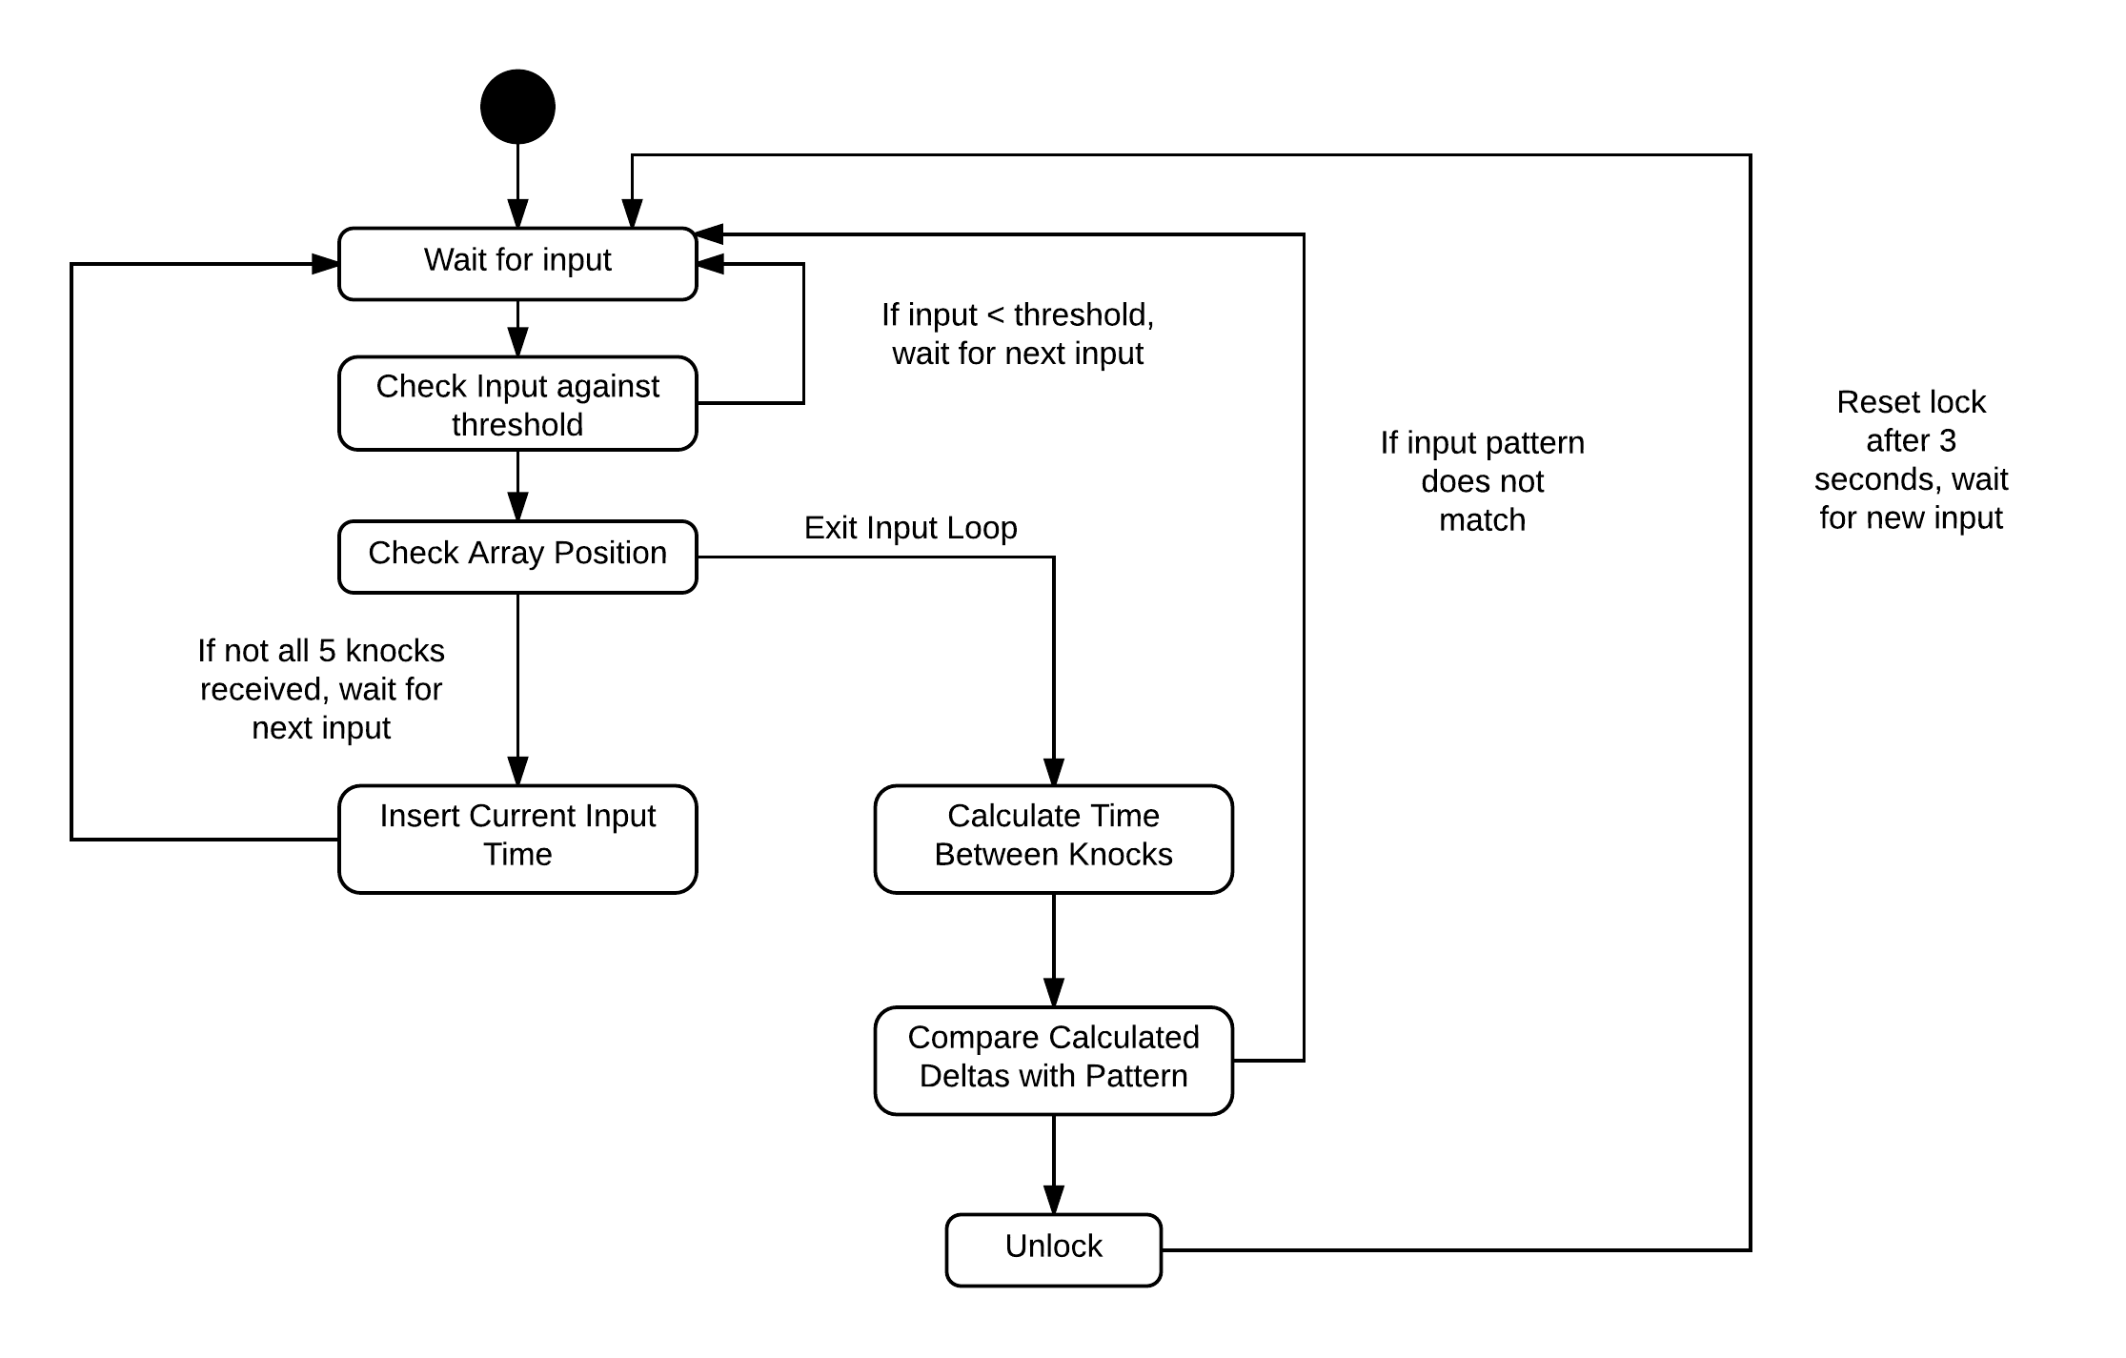
Block Diagram

Slide 6
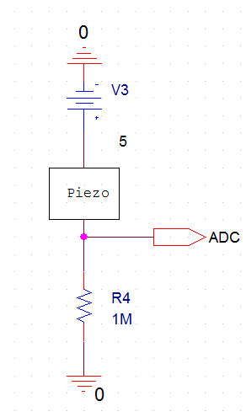
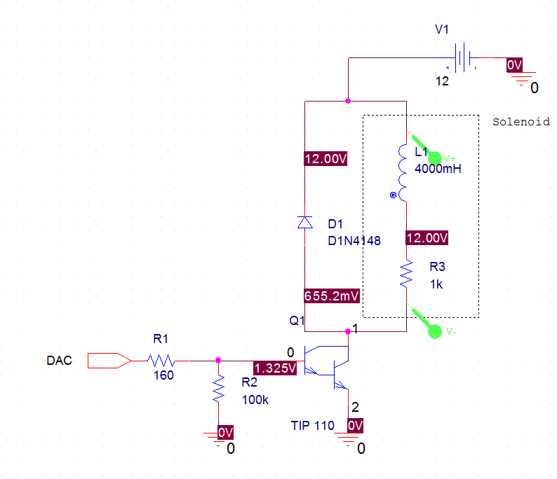

Slide 7
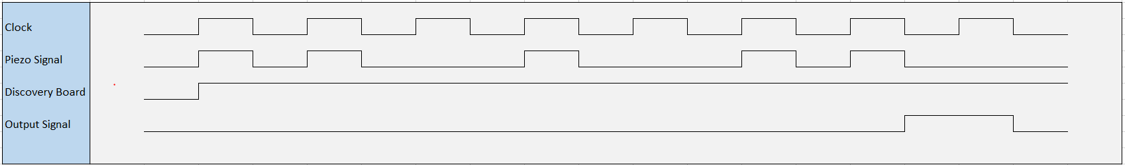
Timing Diagrams

